Slide 1
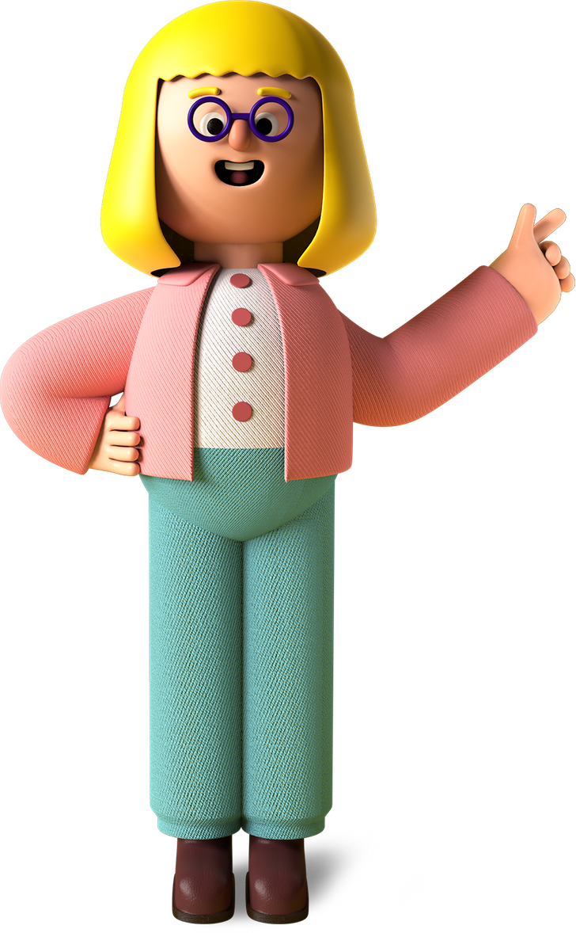
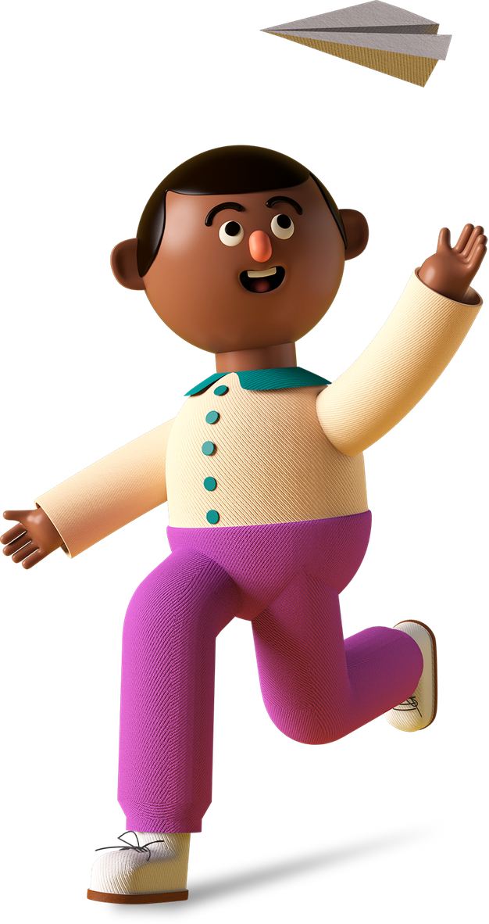
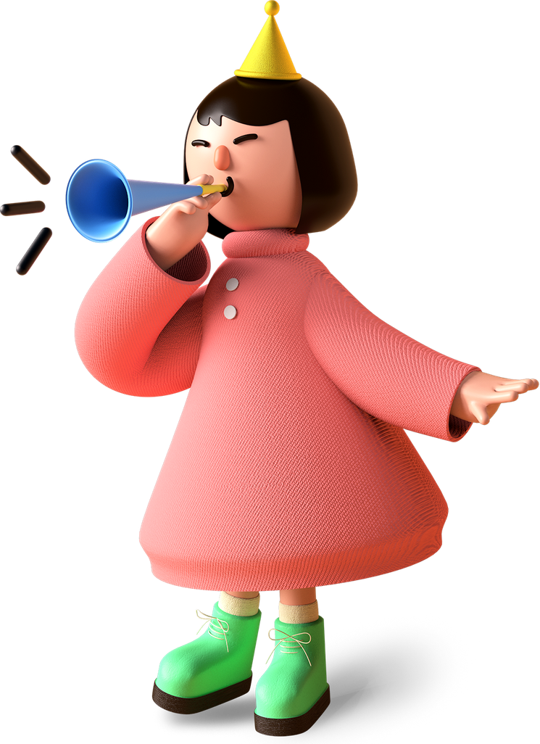
Anoushka’s fav Project

Slide 2

Project Name
Fruit Ninja

Slide 3
Project Link
https://editor.p5js.org/anoushka_112008/full/fcD1gQEgk

Slide 4
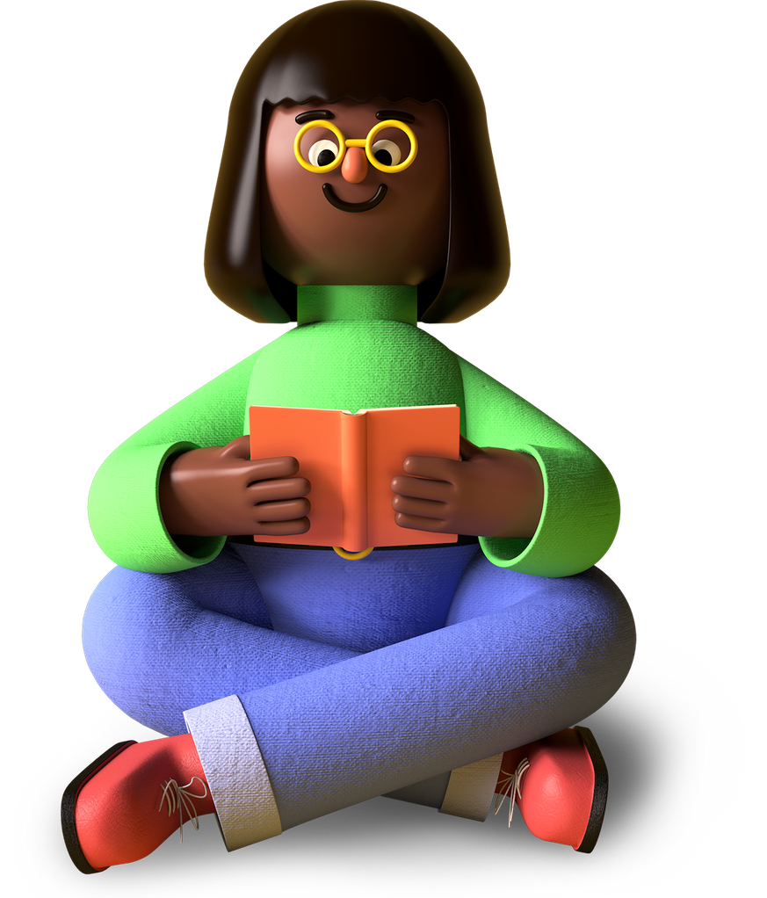
My favorite part about the project
Cutting the Fruits
The cute button monsters

Slide 5
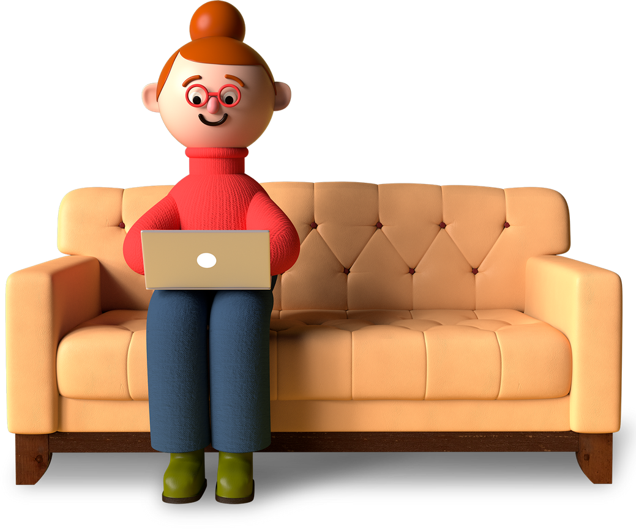
What I learned from it
01
How to create a function and spawn it.
02
How to display different fruits using random numbers.
03
How to create a group of objects.

Slide 6
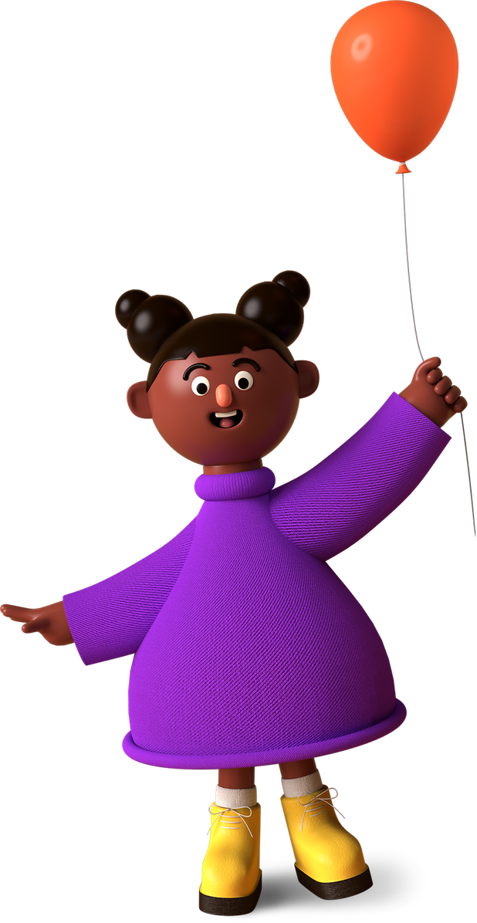
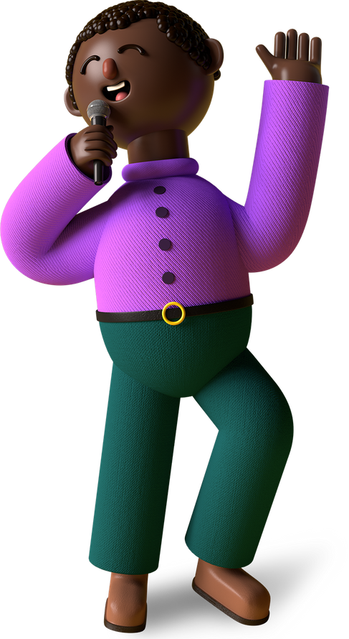
Thank You, Mumma & Papa.
Merry X’Mas & A Happy New Year !!
From (Anoushka),
A Talented Young Coder In The Making!

